Slide 1
Text compression using various algorithms

Slide 2
Table of Contents
Introduction to text compression
Run length encoding algorithm(RLE)
Huffman algorithm
Time complexity
Conclusion

Slide 3
What is text compression ?
Text compression algorithms aim at statistical reductions in the volume of data.
It involves changing the representation of a file so that the (binary) compressed output takes less space to store, or less time to transmit
Still the original file can be reconstructed exactly from its compressed representation.
Need for text compression:
Uncompressed data can take up a lot of space, which is not good for limited hard drive space and internet download speeds.
While hardware gets better and cheaper, algorithms to reduce data size also help technology evolves.

Slide 4
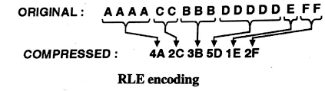
Run length encoding (RLE)
picks the next unique character and appends the character and it's count of subsequent occurrences in the encoded string.
single value and count.
If a byte occurs atleast four times in a row, then the number of occurrences is counted.
The compressed data contain the byte, followed by the M-byte and the number of occurrences of the byte.
This type of data compression is lossless, meaning that when decompressed, all of the original data will be recovered when decoded.

Slide 5
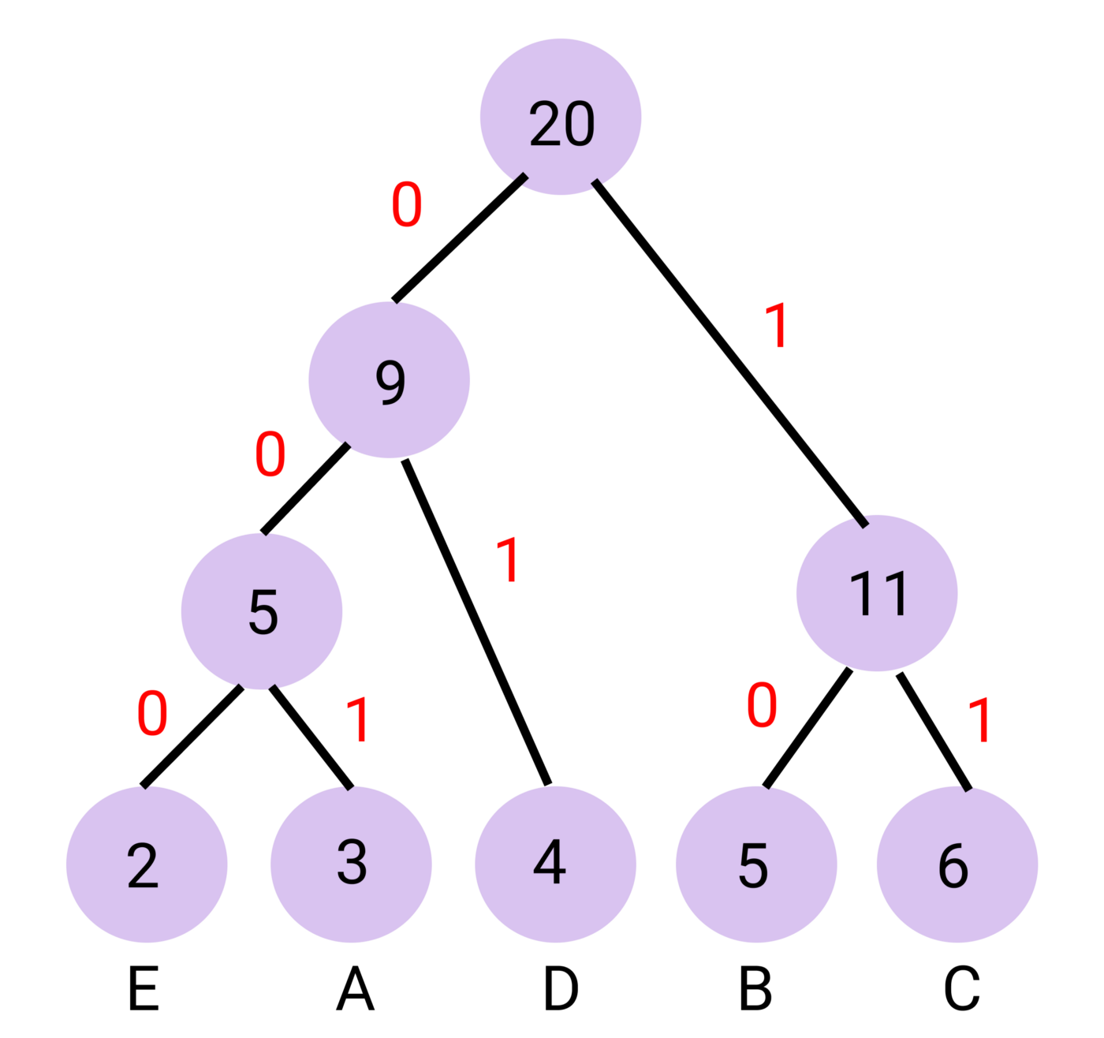
Huffman Algorithm
Huffman algorithm is a lossless data compression algorithm
Variable length codes are assigned to input characters
based on their frequencies.
Ensures there is no ambiguity in decoding the generated
bitstream.
Huffman Coding is generally useful to compress the data
in which there are frequently occurring characters.
Huffman coding is used in conventional compression
formats like GZIP, BZIP2, PKZIP, etc.

Slide 6
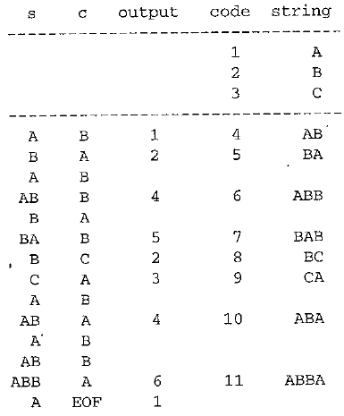
LZW (Lempel-Ziv-Welch)
LZW is lossless compression .
It has the potential for very high throughput in hardware implementations.
It is the algorithm of the widely used Unix file compression utility compress and is used in the GIF image format.
The Idea relies on reoccurring patterns to save data space.
LZW is the foremost technique for general-purpose data compression due to its simplicity and versatility.

Slide 7
Time complexity
Huffman Algorithm
The time complexity analysis of Huffman Coding is as follows-
getNode( ) is called 2 x (n-1) times if there are n nodes.
As getNode( ) calls buildHuffmantree( ), it takes O(logn) time.
Thus, Overall time complexity of Huffman Coding becomes O(nlogn).
Here, n is the number of unique characters in the given text.
Run Length Encoding Algorithm (RLE)
The time complexity analysis of RLE is O(n)
Lempel-Ziv-Welch (LWZ)
The time complexity analysis of RLE is O(n)

Slide 8
Conclusion
Huffman coding technique involves evaluation of the probabilities of occurrence “on the fly”, as the ensemble is being transmitted and RLE is based on finding the runs of the data.
Huffman is computationally more expensive than RLE.
RLE does not support numeric values.
RLE performs poorly on large amounts of data.
LZW requires no prior information about the input data stream unlike Huffman and RLE.
LZW can compress the input stream in one single pass.
Another advantage of LZW is its simplicity, allowing fast execution over huffman.

Slide 9
References
[1] Namburi, S., Muvva, P., Krishna Rao, P. and G, P., 2020. A NEW APPROACH TO INCREASE LZW ALGORITHM COMPRESSION RATIO. International Journal of Engineering Applied Sciences and Technology, 04(10), pp.141-144.
[2] X. Ma, C. Xu, P. Zhang and C. Hu, "The Application of the Improved LZW Algorithm in the Data Processing of GNSS Simulation," 2012 Fourth International Conference on Computational and Information Sciences, 2012, pp. 160-163, doi: 10.1109/ICCIS.2012.319.
[3] Al-Laham, M. and El Emary, I.M., 2007. Comparative study between various algorithms of data compression techniques. IJCSNS, 7(4), p.281.
[4] Amartya Ranjan Saikia “Lempel–Ziv–Welch” Geeksforgeeks.com 08 Nov, 2021.
[5] S. Jain, “The N Queens Problem,” Tutorials Horizon, 2017
[6] Utkarsh Trivedi, “Remove Invalid Parentheses”. Geekforgeeks.com. Updated : 07 Mar, 2022
[7] Pandey, V., 2021. M-coloring Problem. [online] Codingninjas.com. Available at: <https://www.codingninjas.com/codestudio/library/m-coloring-problem> [Accessed 28 October 2021].

Slide 10
Thank You

